Slide 1


















Vehicle Rental Application
Elita 5-1

Slide 2
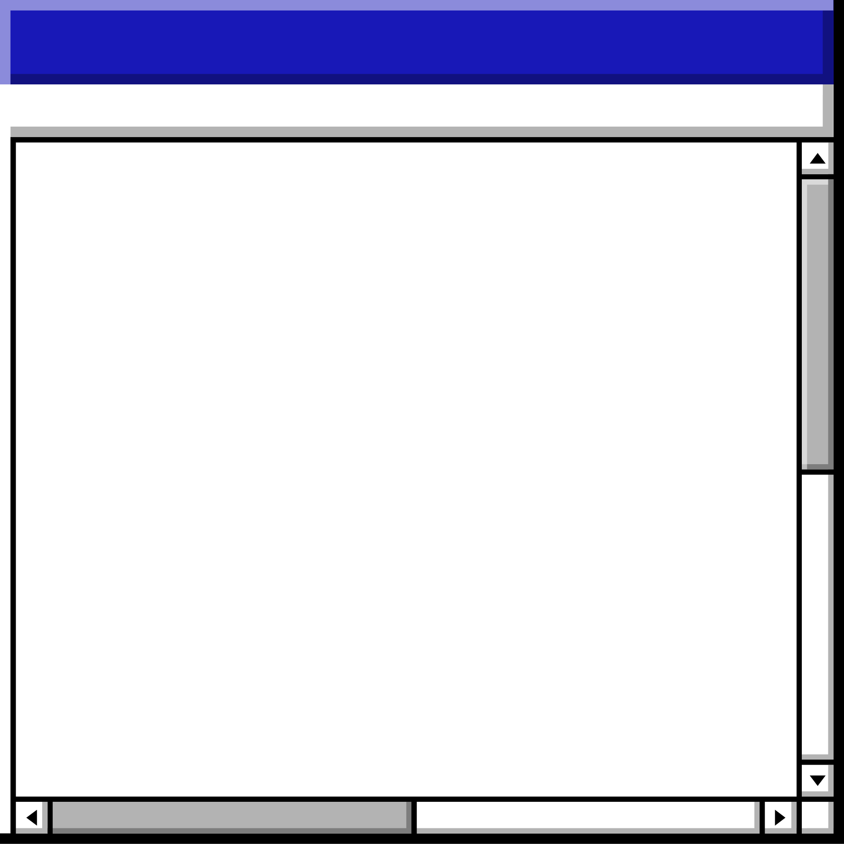

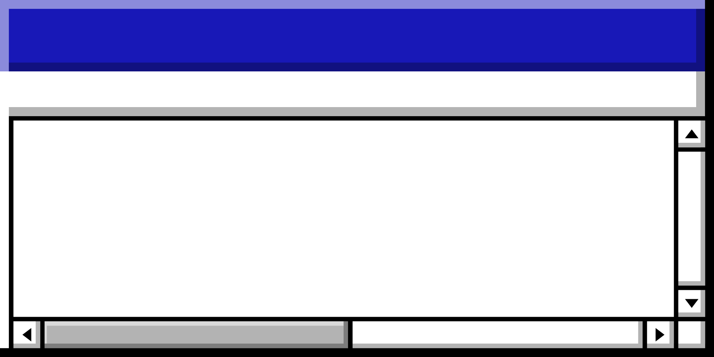


• SubTopics• SubTopics • SubTopics• SubTopics• SubTopics • SubTopics • SubTopics • SubTopics• SubTopics • SubTopics• SubTopics• SubTopi
Topics Covered
Aurora
Ema
SubTopics
Keit
Klea
Extra Feature

Slide 3


Aurora`s Work
Aurora`s functions:
Display all vehicle information.
Search for a vehicle using the license plate number.
Cancel a reservation. (delete)
Display the name, surname and Client ID of all clients who have rented a vehicle more than 3 times.
Back to SubTopics Page

Slide 4


Ema's Work
Ema`s functions:
Display vehicles that will be available after x days.
Create a new reservation.
Remove a vehicle. (delete)
Date manipulation functions
Back to SubTopics Page

Slide 5


Keit's Work
Keit`s functions:
Sort and display all vehicles according to their daily rental price.
Display all reservations.
Modify information for a vehicle using its plate number.
Back to SubTopics Page

Slide 6


Klea's Work
Klea`s functions:
Display available vehicles currently.
Display the top 3 most reserved vehicles.
Save all reservations exceeding x to a new File
Koha function (that gives the user the current Date)
Add a new vehicle.
Back to SubTopics Page

Slide 7














• Challenges • Challenges • Challenges • Challenges • Challenges • Challenges • Challenges • Challenges • Challenges • Challenges
Challenges
As we tried to divide the tasks and have each member work on them separately, we ran into a few difficulties when ensuring the functionality of the units.
We tried to integrate the code from the beginning, however we ran into several issues, related to the functions which implemented time.
ERROR
• Challenges • Challenges • Challenges • Challenges • Challenges • Challenges • Challenges • Challenges • Challenges • Challenges

Slide 8
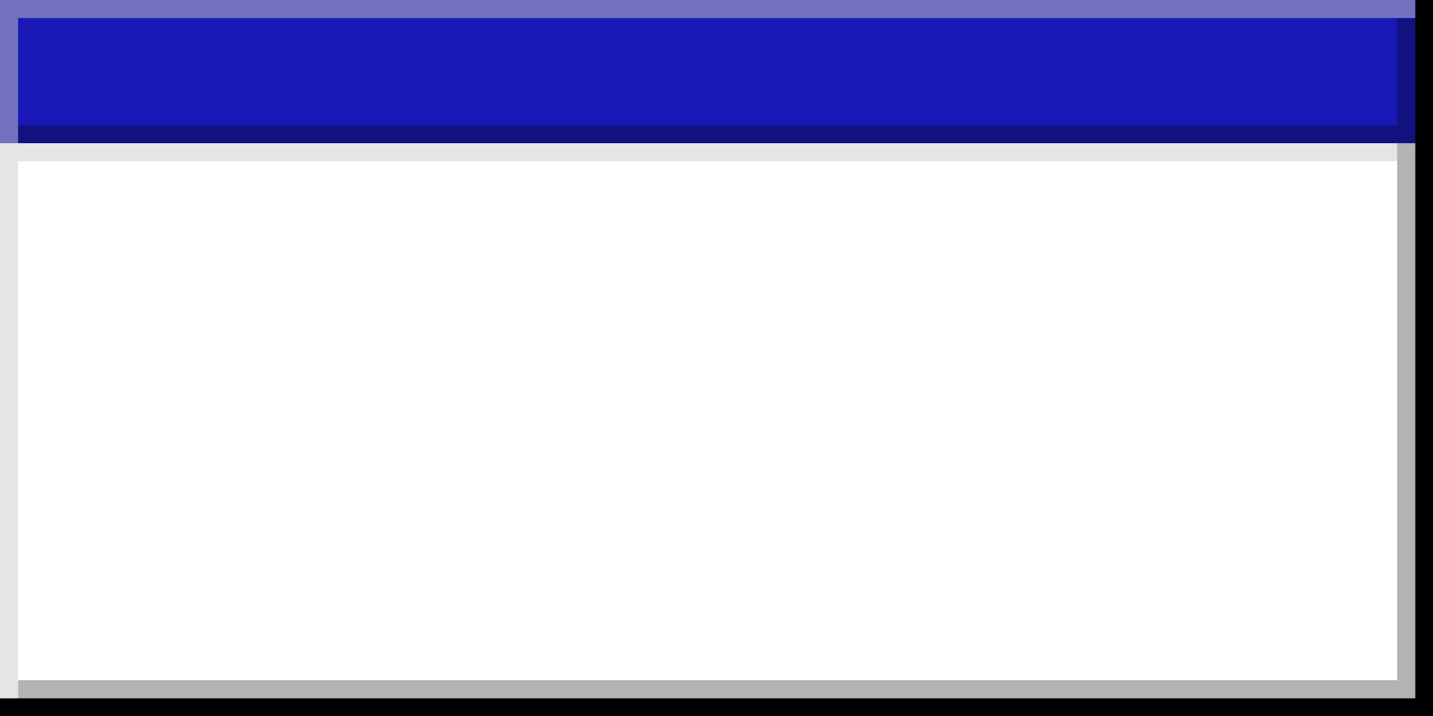

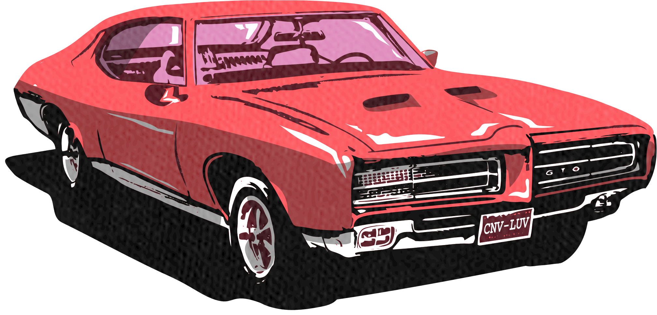
Data Structure • Data Structure • Data Structure • Data Structure • Data Structure • Data Structure • Data Structure • Data Structure
3 Linked Lists
As we know link lists are structures
-Clients
-Reservation
-Vehicle
Structures are double the number of linked lists to differentiate between the data and the link of the lists
6 structures
Data Structure • Data Structure • Data Structure • Data Structure • Data Structure • Data Structure • Data Structure • Data Structure

Slide 9
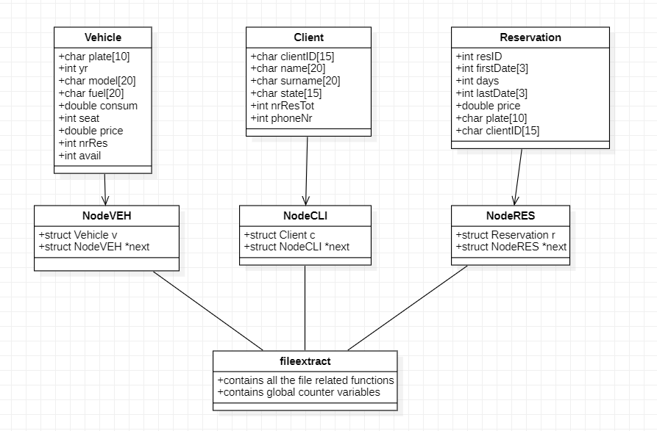
Data Structure • Data Structure • Data Structure • Data Structure • Data Structure • Data Structure • Data Structure • Data Structure
How the data is structured:
Data Structure • Data Structure • Data Structure • Data Structure • Data Structure • Data Structure • Data Structure • Data Structure

Slide 10


Feature
We have incorporated a calendar into our program as an additional functionality. Before reserving a vehicle for a specific duration, you may conveniently consult the calendar to ascertain the precise days your reservation encompasses.
Back to SubTopics Page

Slide 11

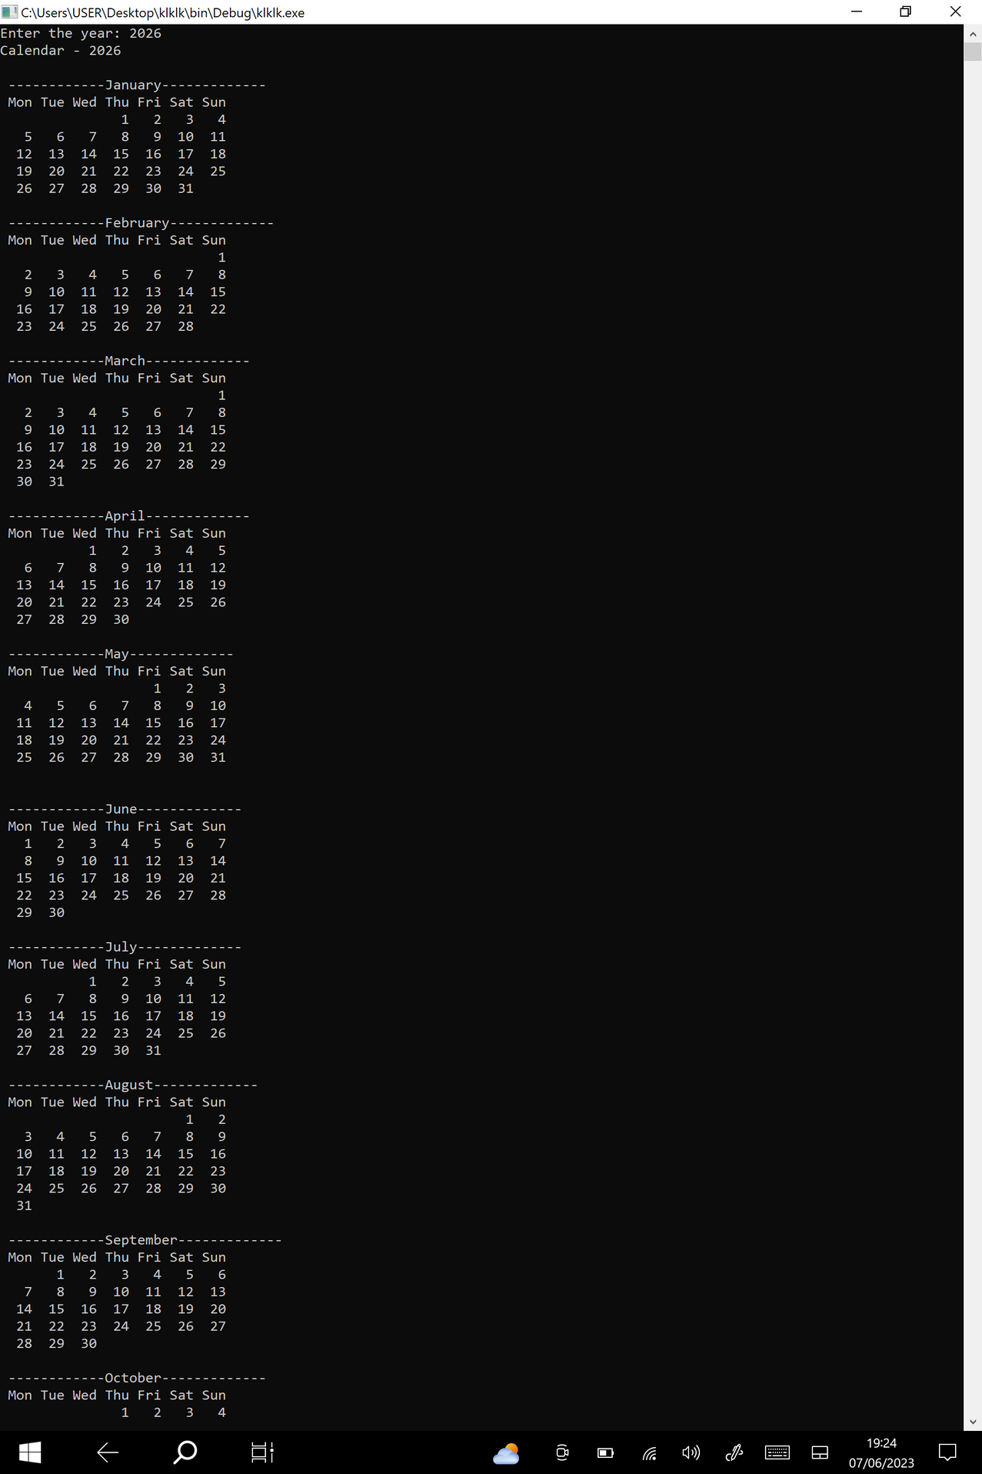
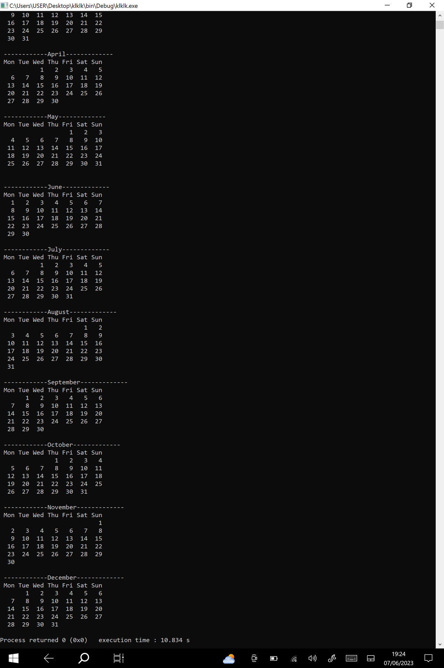
Calendar Page

Slide 12
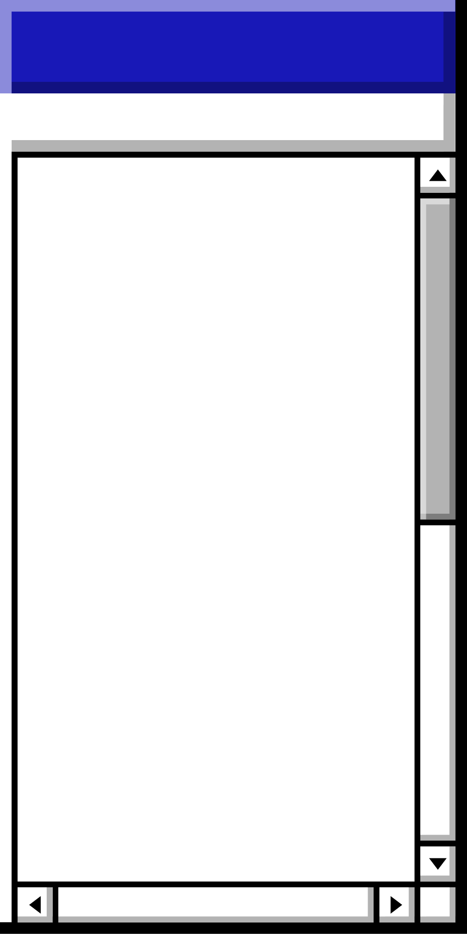

Responsive
Fast
When developing our program, we made sure to leverage our current programming knowledge to create an efficient and user-friendly software solution.
The Best Rental Vehicle Application
User Friendly
Consistent
Efficient
Simple Interface
Easy to use
Understandable
Time Efficient

Slide 13
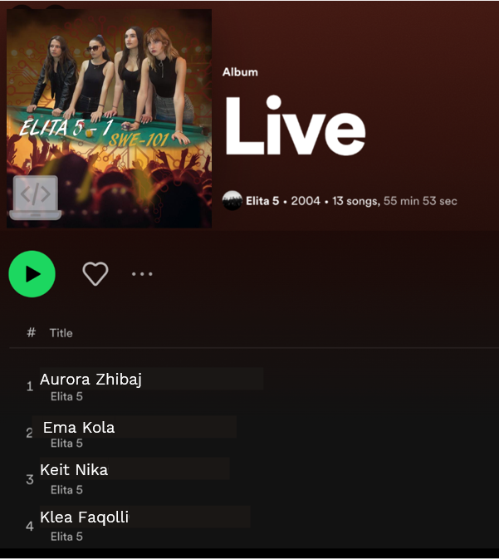
Elita 5-1
Buy our app now
you will get a
25% discount of
being our first client.
Back to SubTopics Page

Slide 14
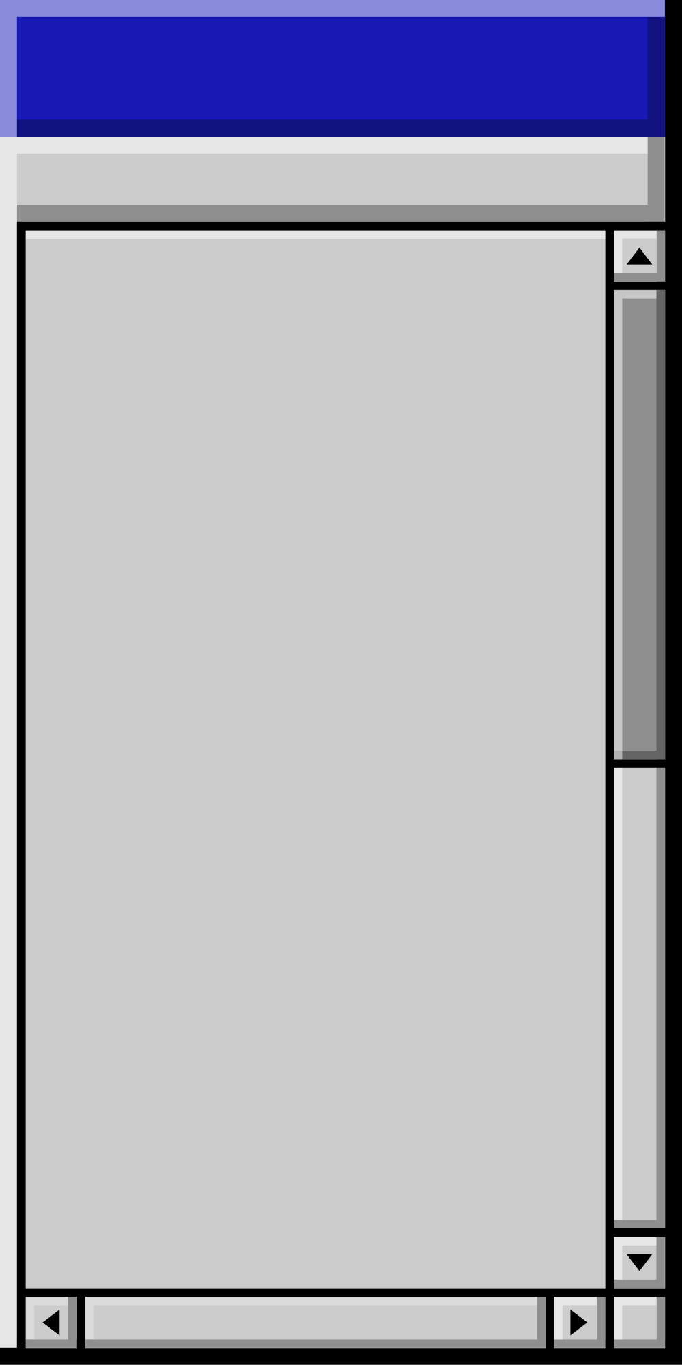
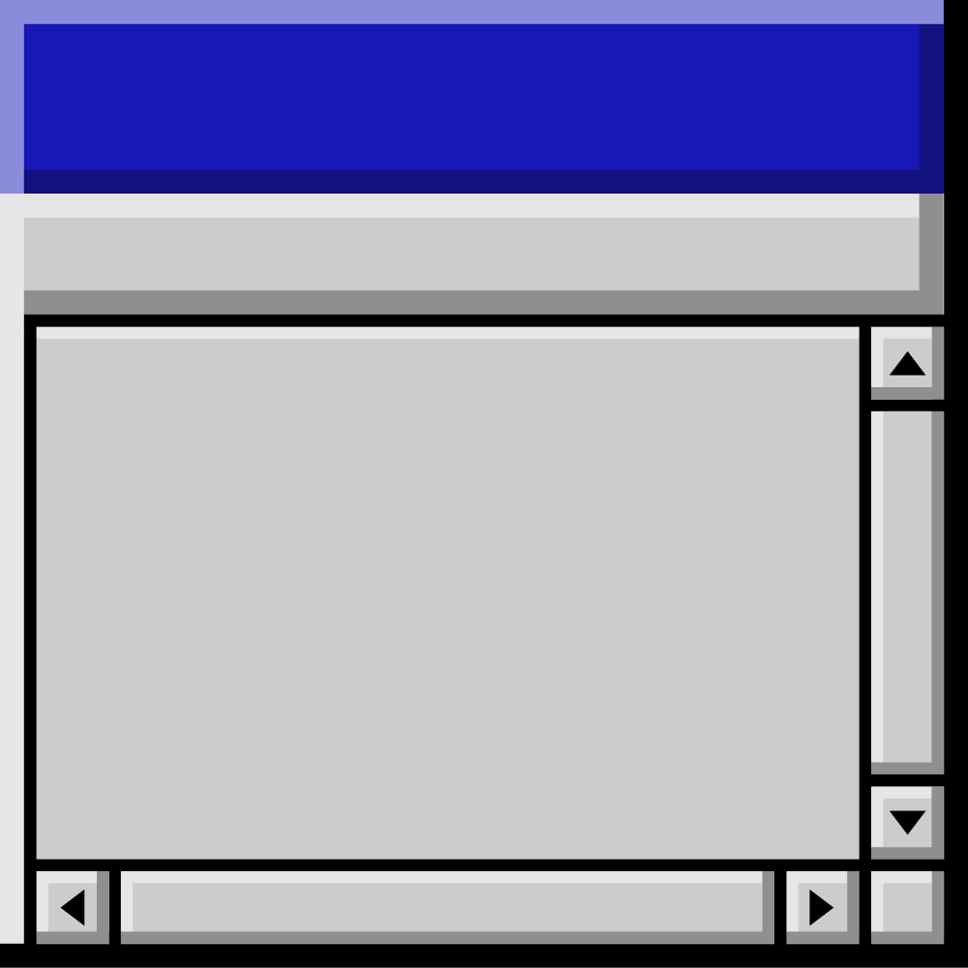
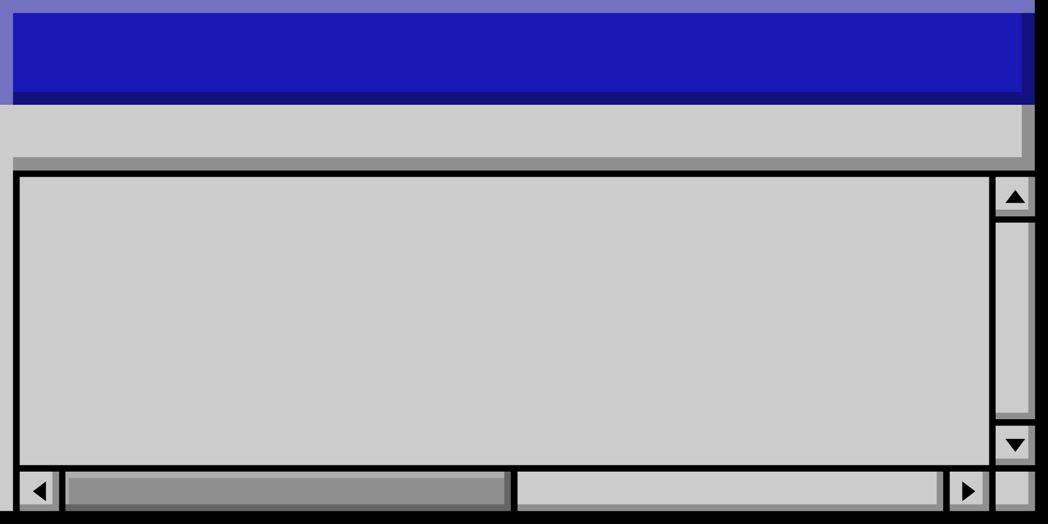
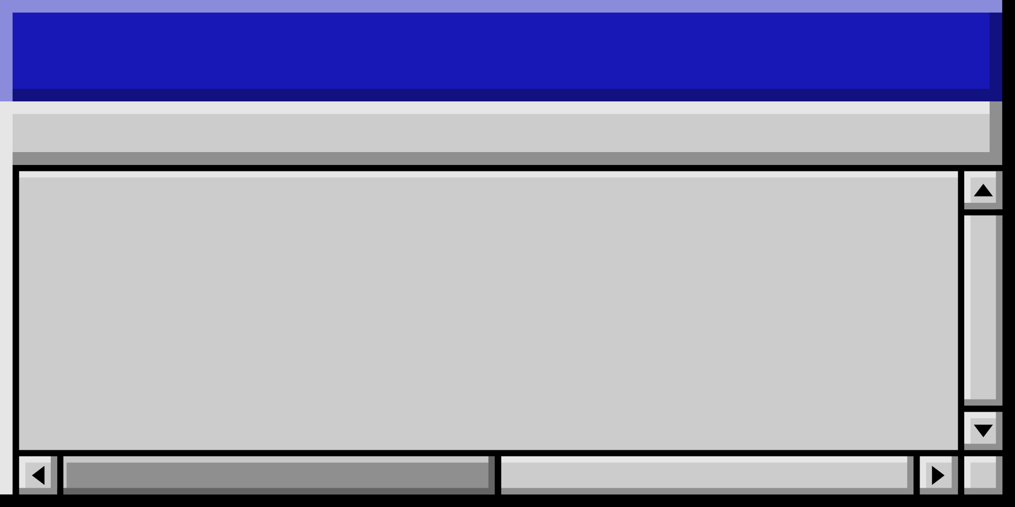
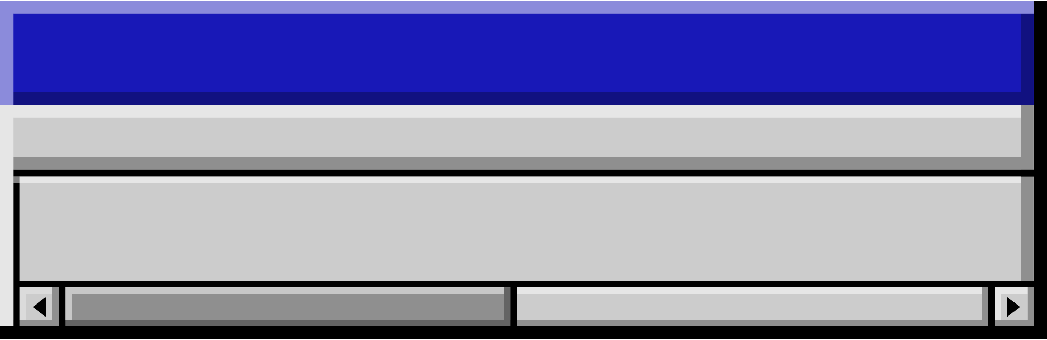
Thank you!

